Slide 1

RUNGTA COLLEGE OF DENTAL SCIENCES AND RESEARCH
Dept of Prosthodontics
3rd Year BDS
Stress Breakers
Presented By:
Dr.Shilpi Karpathak
Professor
Dept of Prosthodontics

Slide 2
Specific Learning Objective
Core areas | Domain | Category
Introduction Basic concepts | Cognitive | Must Know
Role of RPD components in stress components Philosphy of design | Cognitive | Must Know
conclusion | Psychomotor | Must Know
Summary | Affective | Must Know

Slide 3
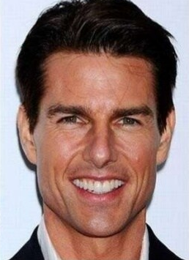

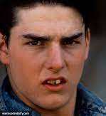

A smile is the prettiest thing you can wear…
Tom Cruise
Emma Watson
Janice Dickinson
Notes:
We all know that your smile can go a long way to creating a positive self image.
There is no exception to this rule in Hollywood, having a perfect set of teeth is almost a must-have for anyone gracing our movie screens.
Unfortunately, not many people are born with a perfect smile, which means – cosmetic dentistry and dentures.
dentures are something for the ageing population, but you’d be surprised how many younger people wear them
This Hollywood star wore dentures on the set of Harry Potter when her baby teeth began falling out but she had to maintain Hermione’s dazzling smile.
denied wearing dentures – until they literally fell out of her mouth at a restaurant. Janice Dickinson – Don’t worry, we already knew!
Tom Cruise- didn’t always have his perfect smile.

Slide 4
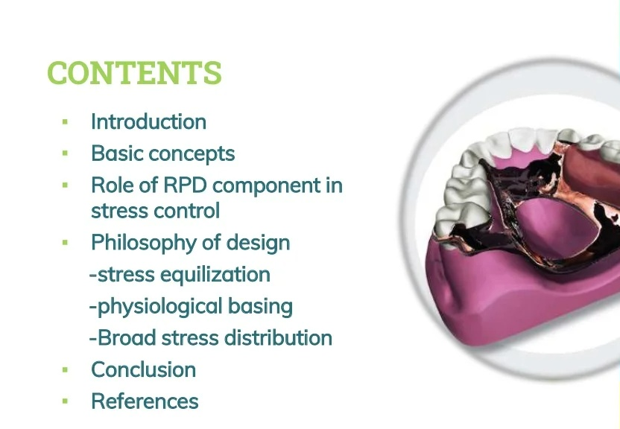

Slide 5
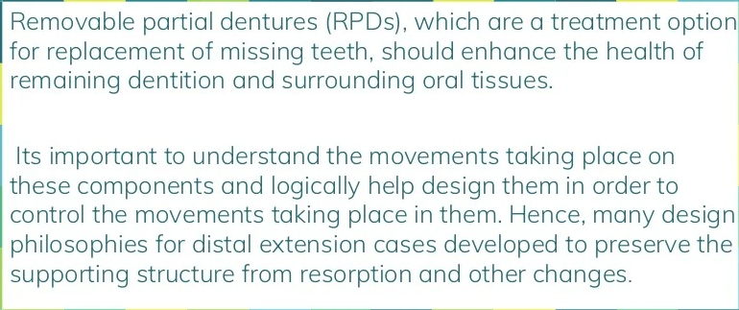
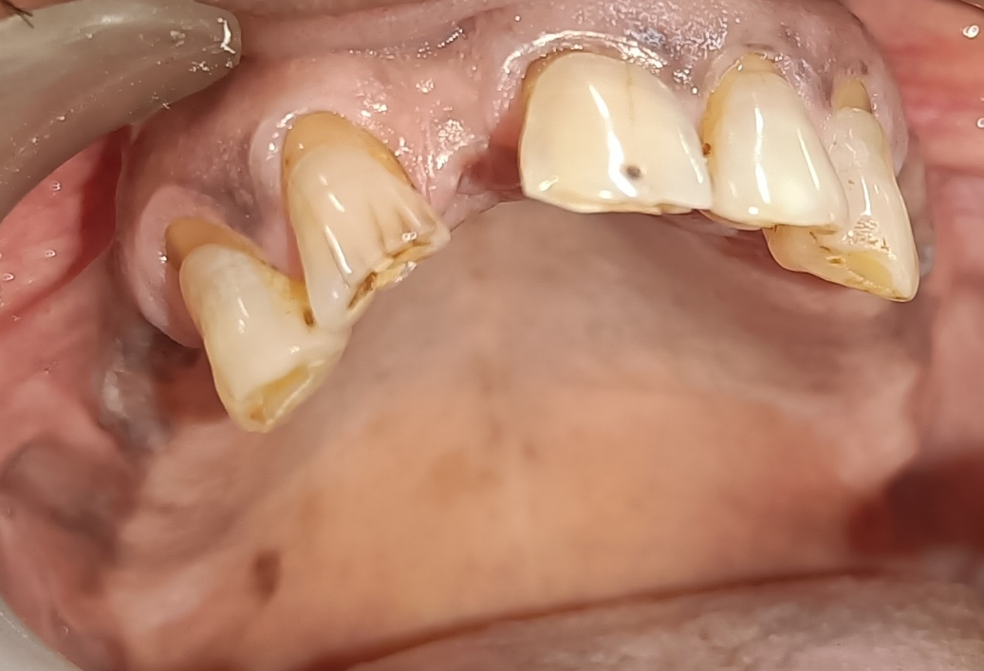
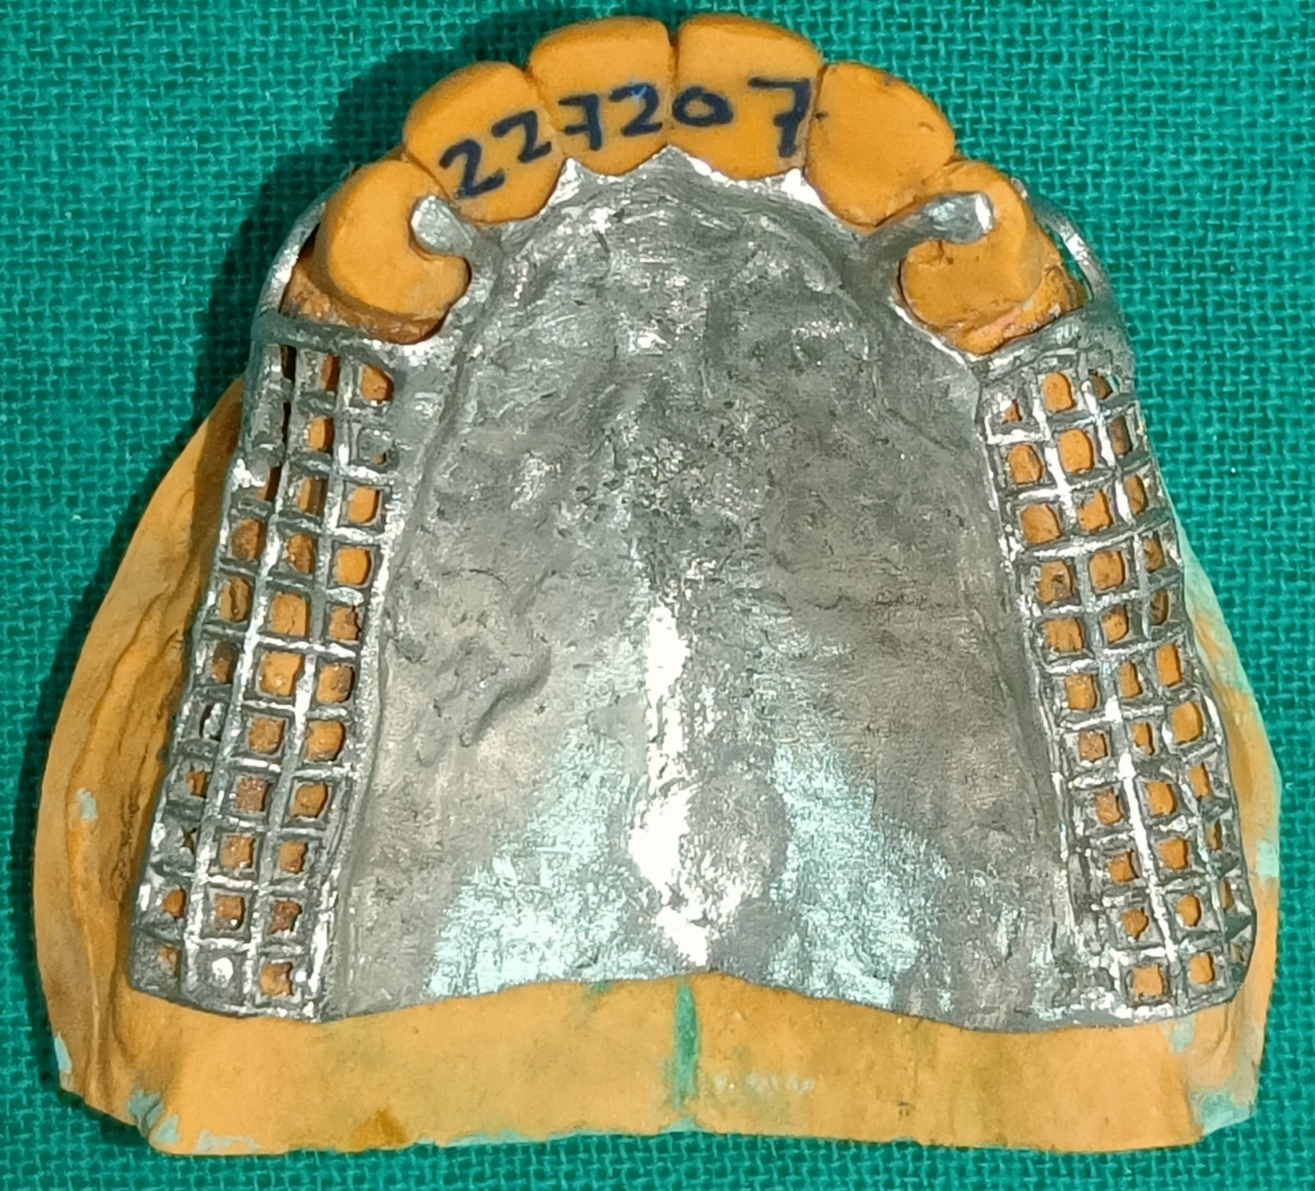
If the physiologic limits of the supporting tissues are respected, then almost any design can be successful.
Notes:
The challenge is primarily in designing class I and II arches and to some extent in class IV arches and distributing the forces acting on the removable partial denture between the soft tissues and teeth.

Slide 6
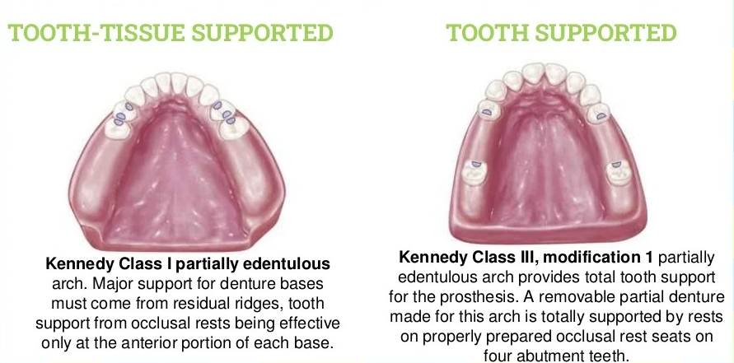

Slide 7
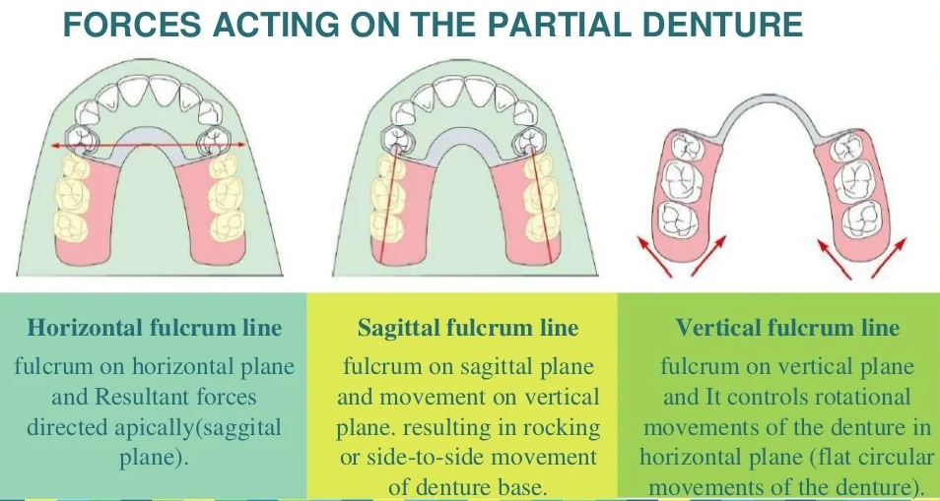

Slide 8
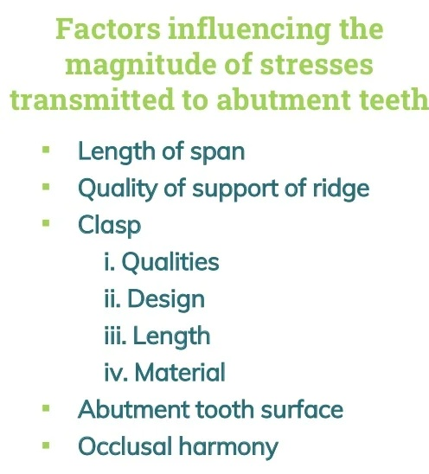
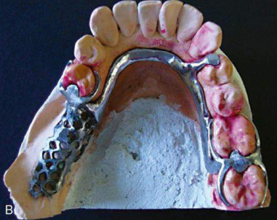

Slide 9
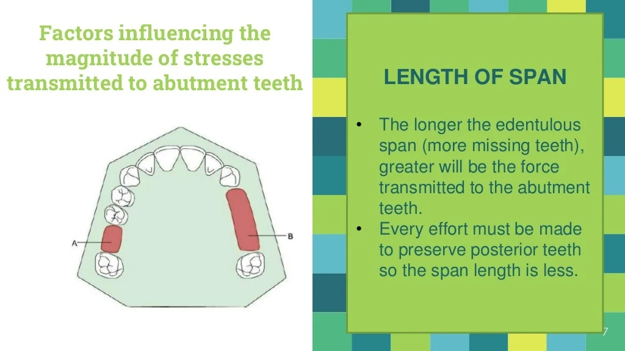

Slide 10
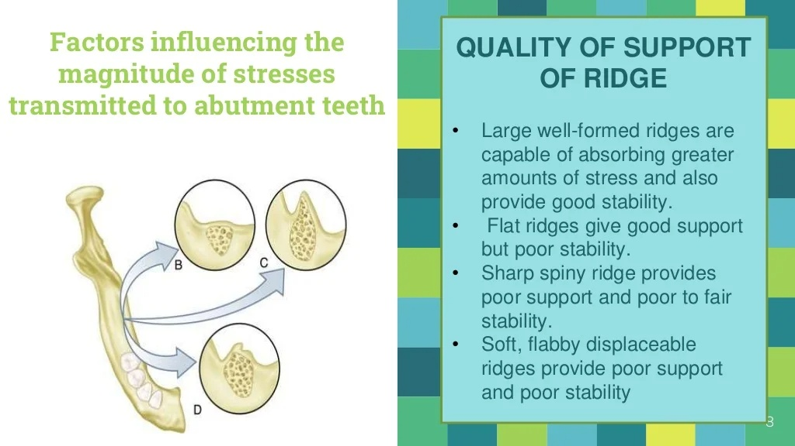

Slide 11
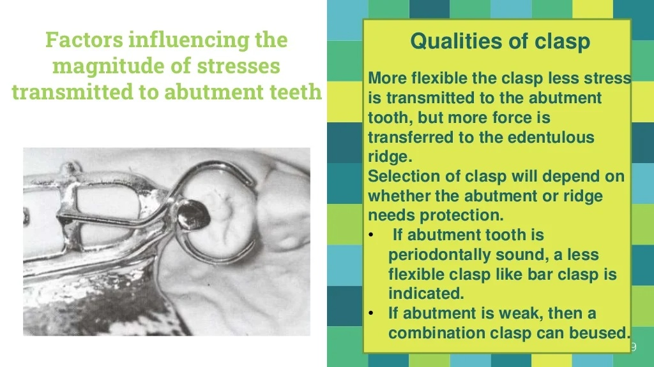

Slide 12
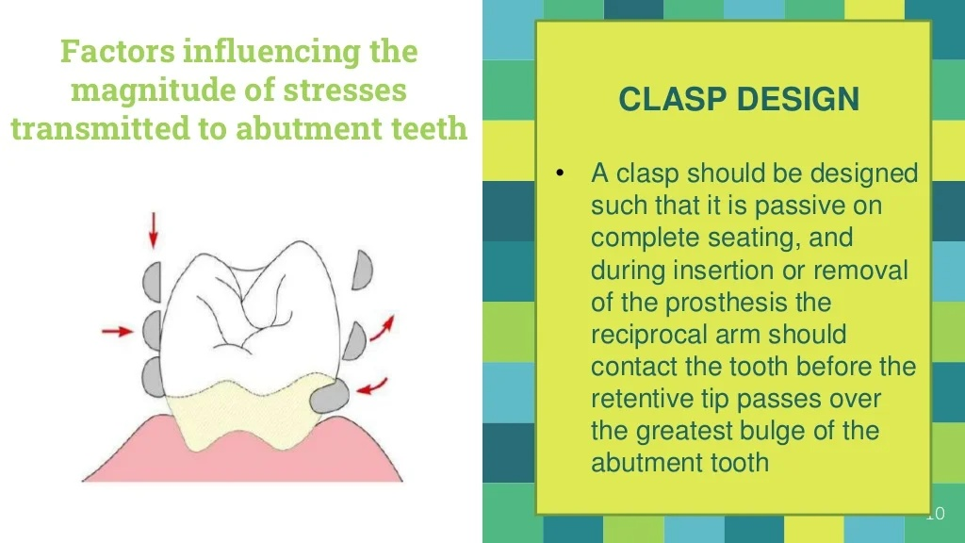

Slide 13
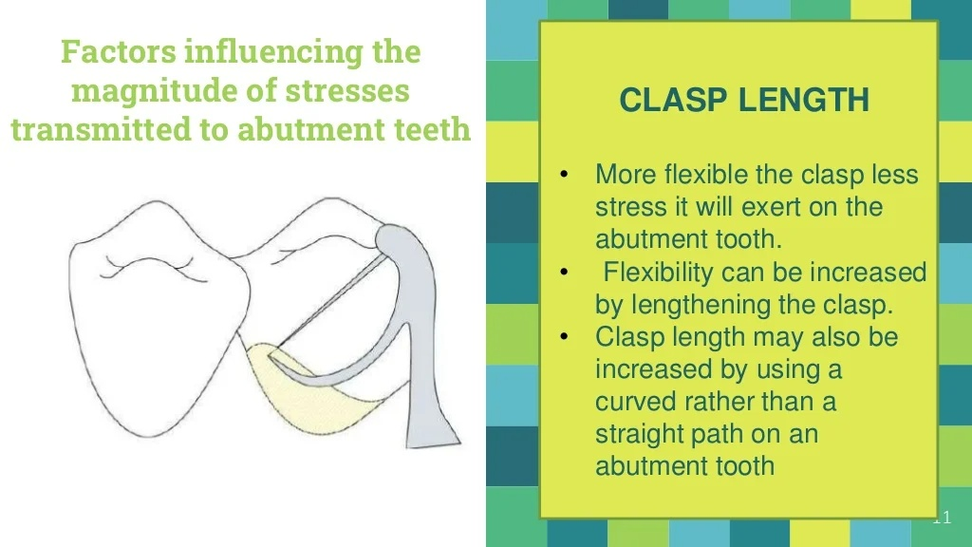

Slide 14
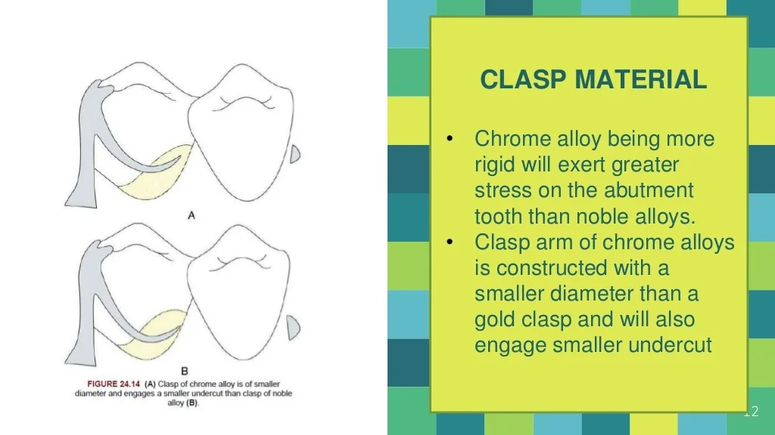

Slide 15
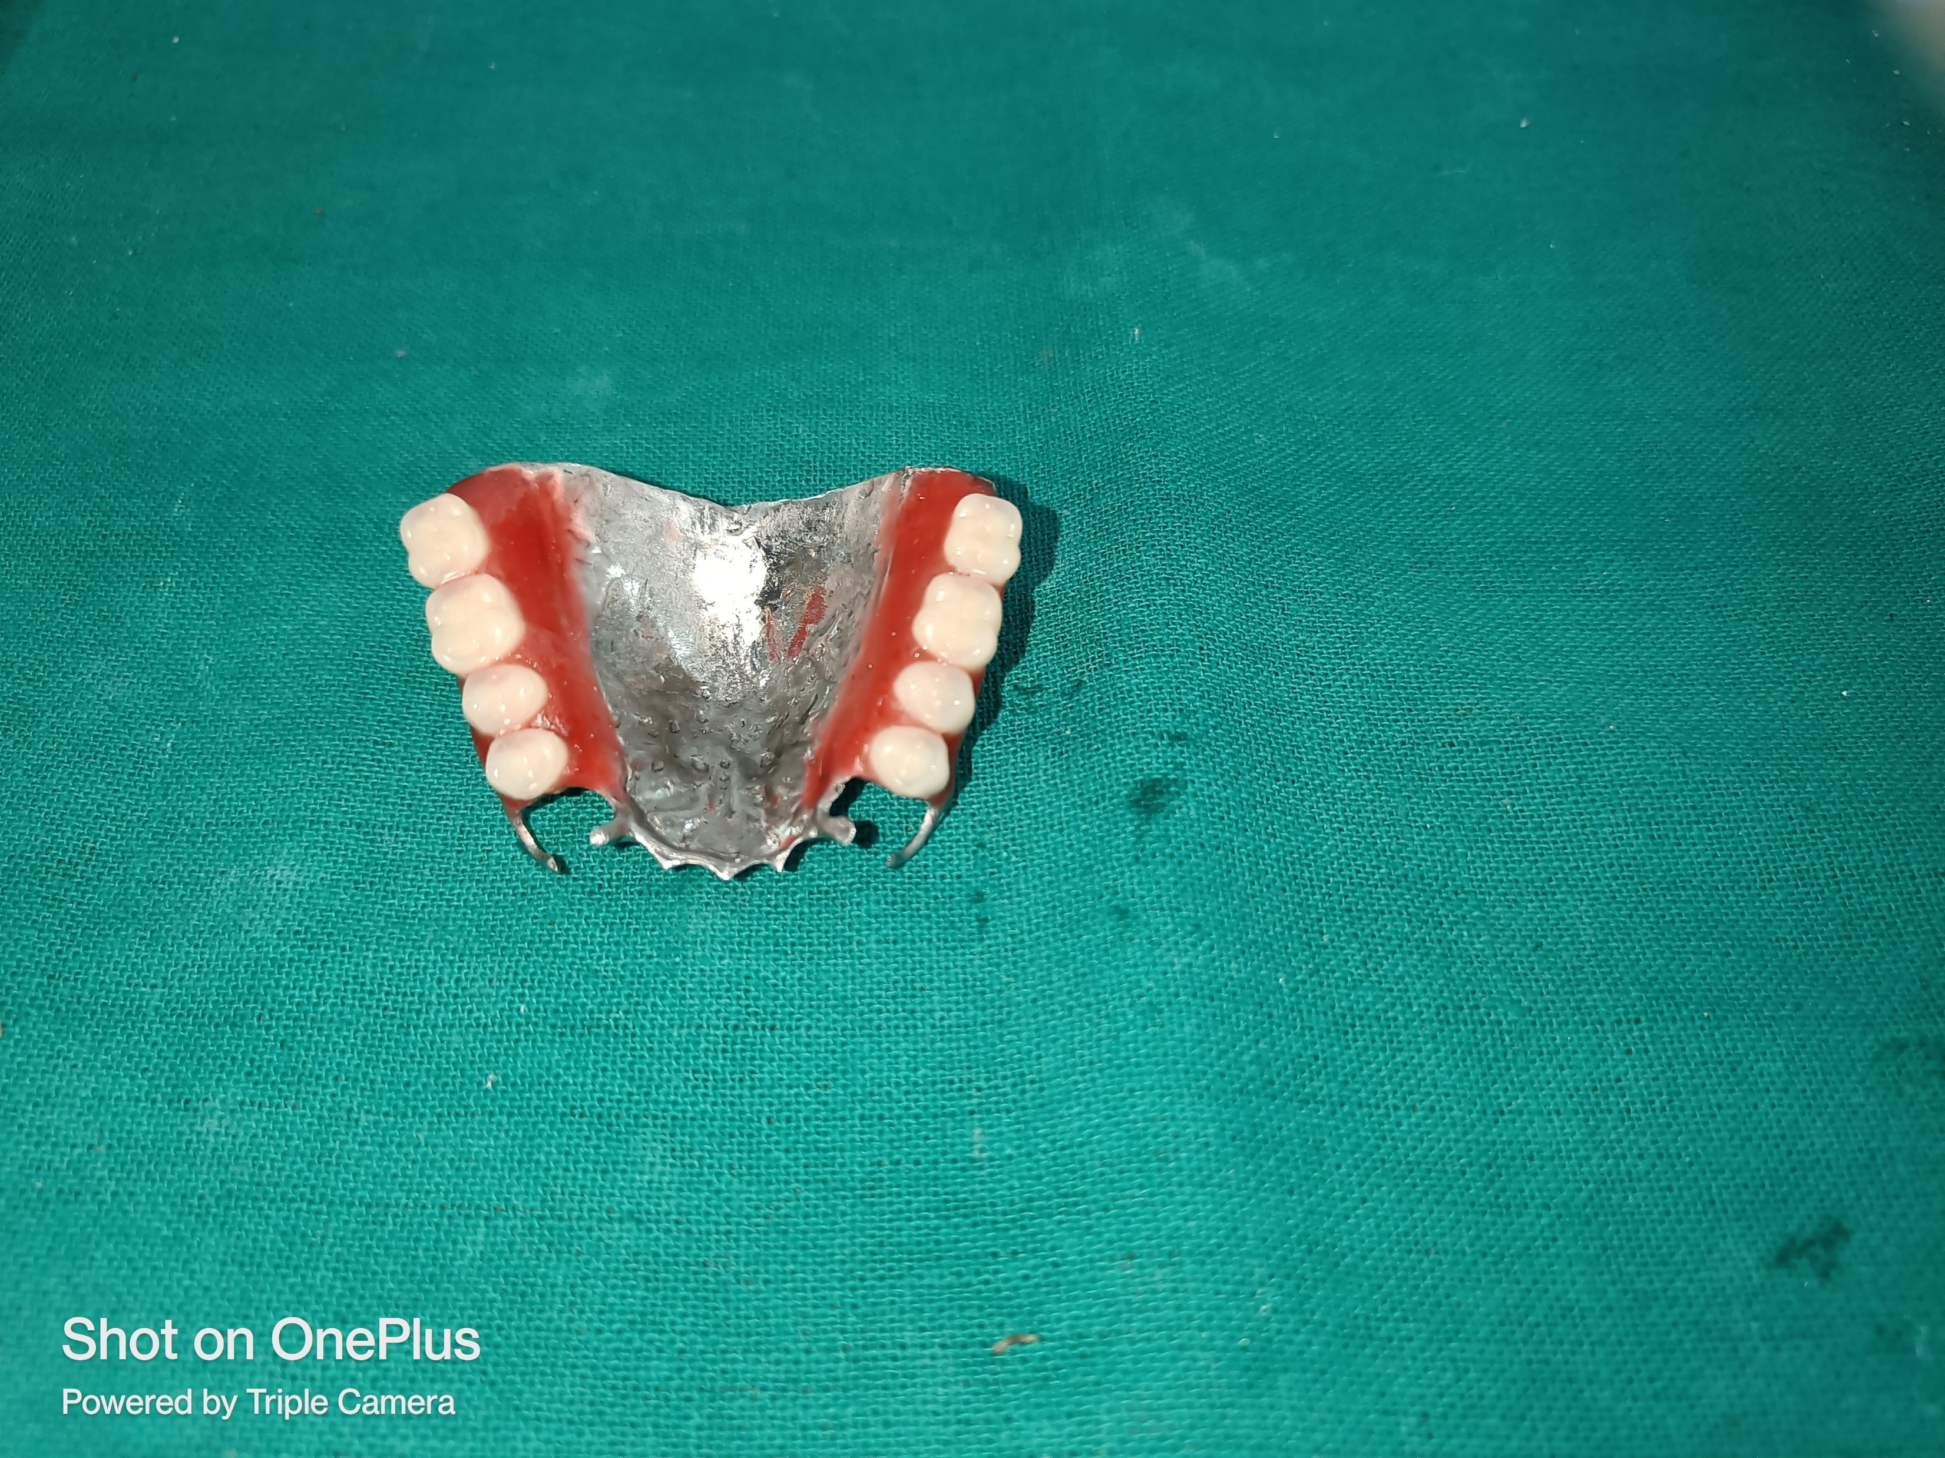
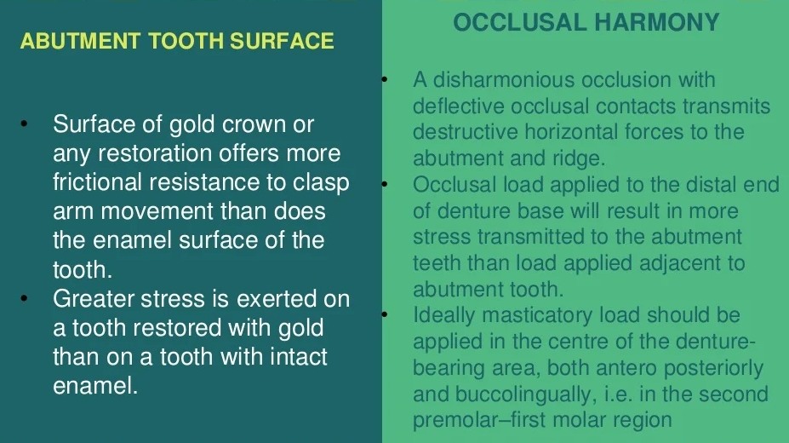
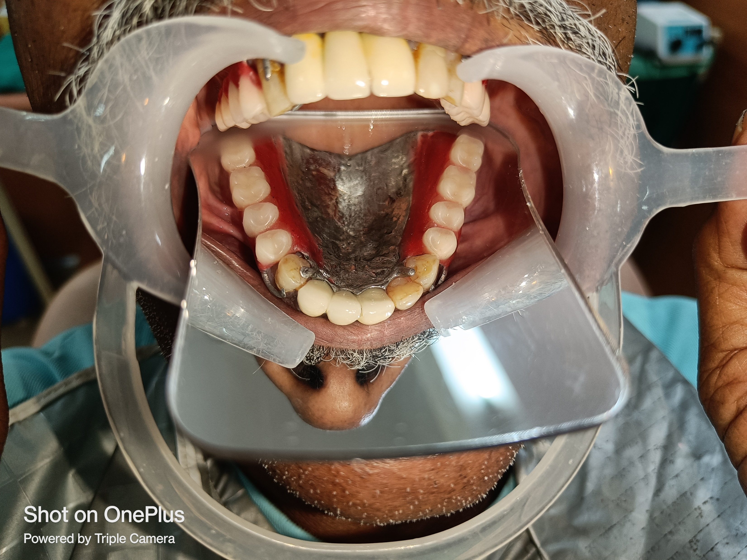

Slide 16
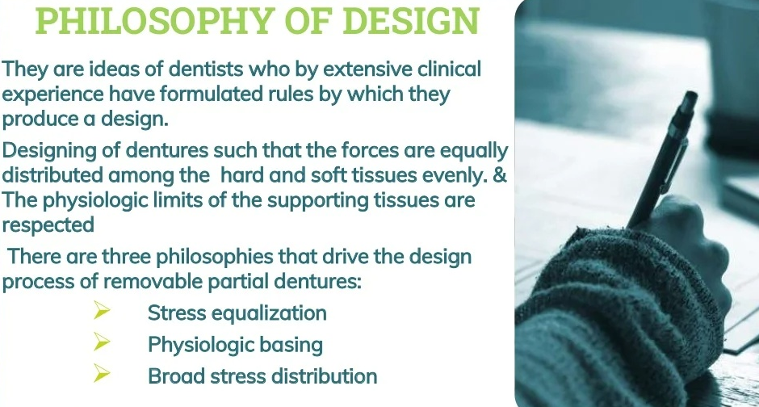
Notes:
Of the various schools of thought, none is backed by scientific research or statistics.

Slide 17
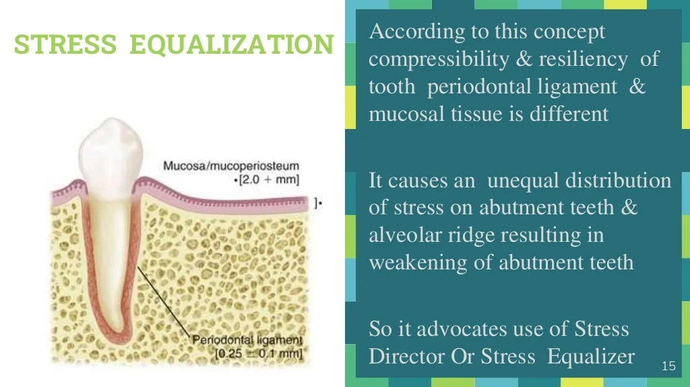

Notes:
type of stress equalizer is needed to replace the rigid connection between denture base and direct retainer and transfer the load from the abutment to the ridge.

Slide 18
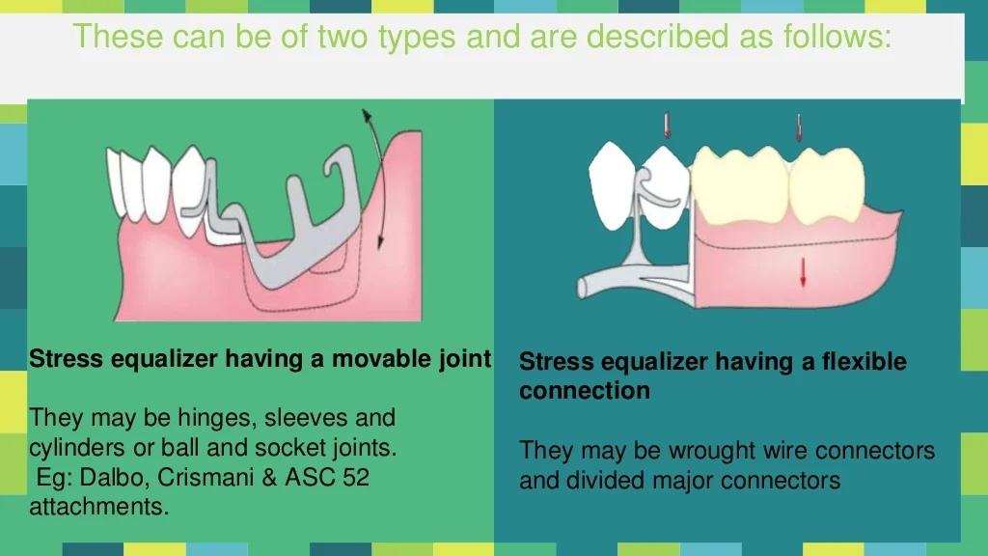

Slide 19
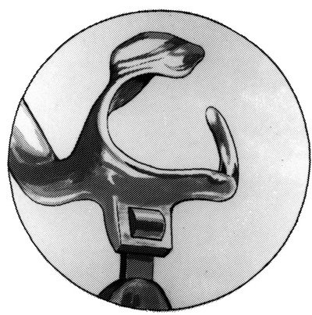
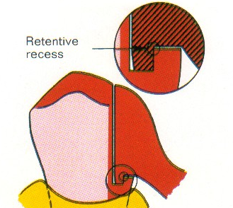
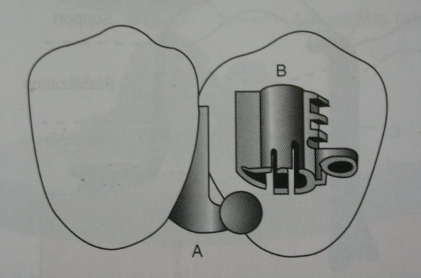
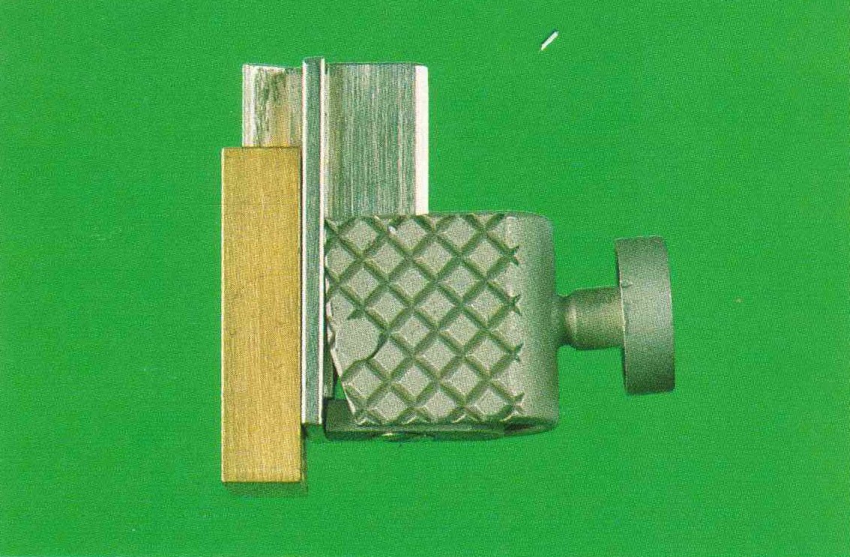
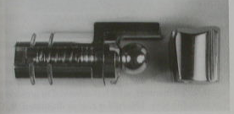
Dalbo attachment
Thompson dowel rest
Dalbo attachment
DSE Hinge
Crismani attachment
ASC-52 attachment

Slide 20
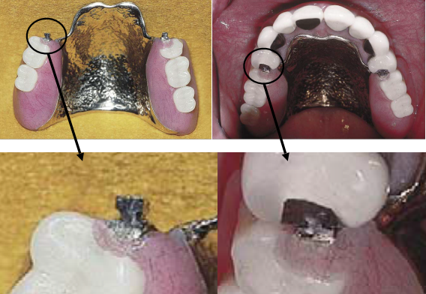
Notes:
Patric – male- DENTURE
Mtric – female - ABUTMENT

Slide 21
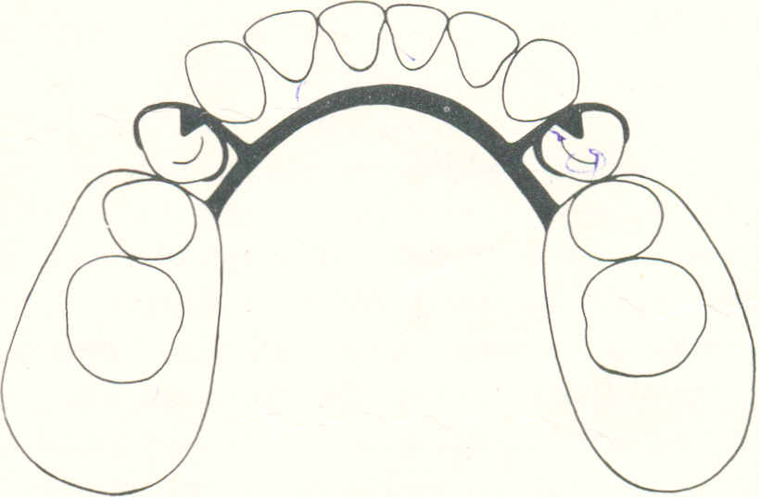
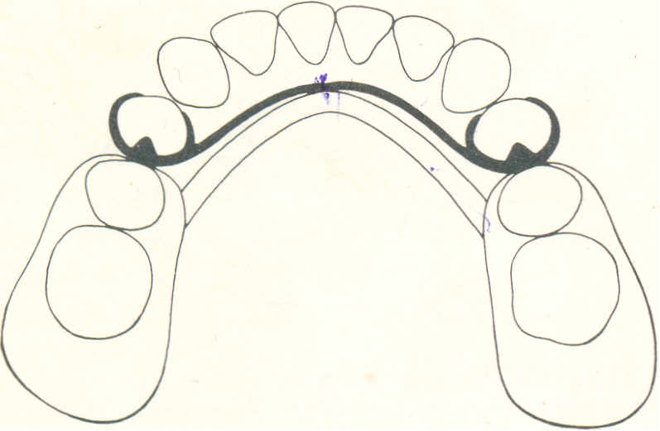
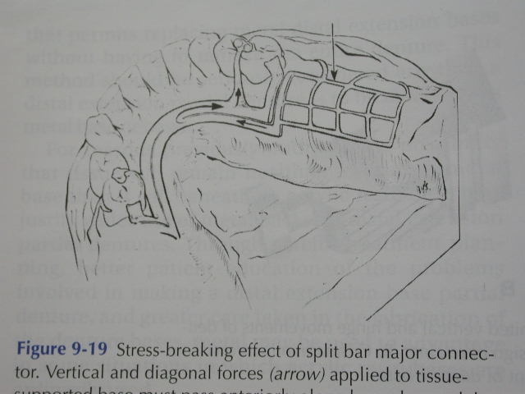
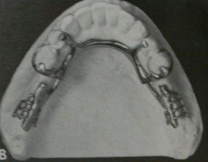
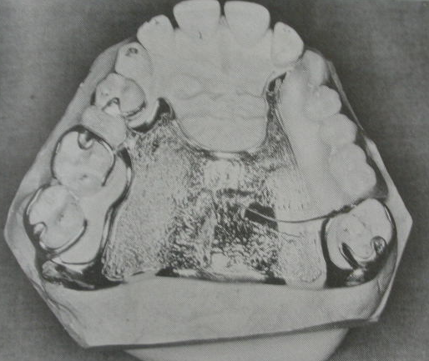
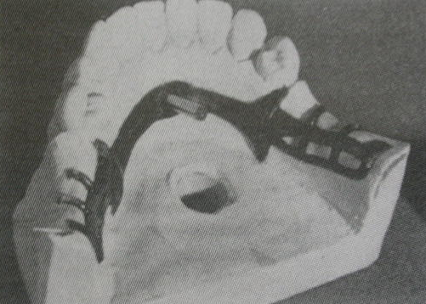
TYPE 2 - Flexible connection between the direct retainer and the denture base.
3. Mesial placement of occlusal rests
1. Split Bar major connector
2. Partial division of connectors
5. Split palate stress breaker
4. 12 gauge chrome wire stress breaker
6. Ticonium hidden lock design
Notes:
Lab-dual casting technique.

Slide 22
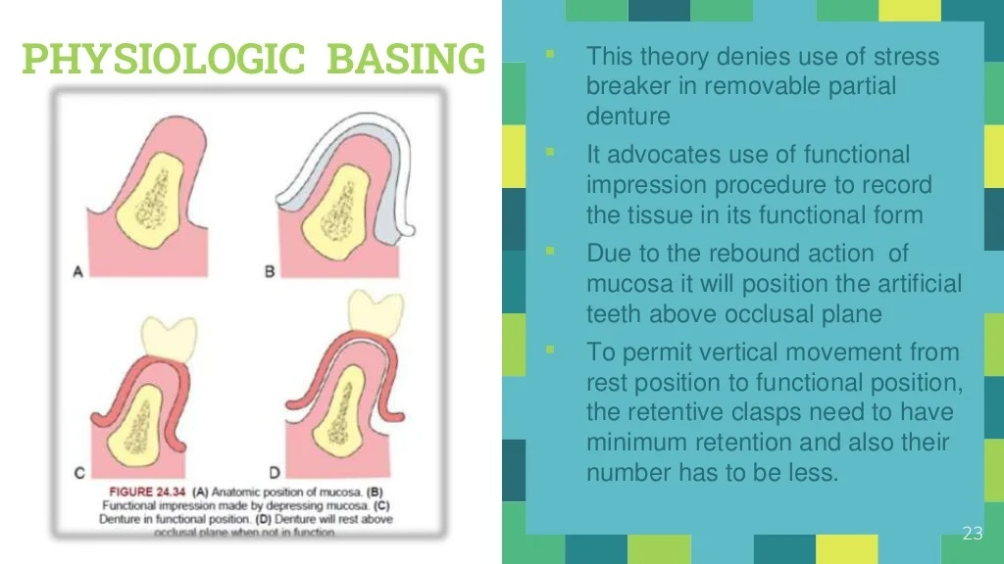
Notes:
The proponents of this theory also believe that there is relative lack of movement in abutment teeth in an apical direction compared to the ridge.

Slide 23
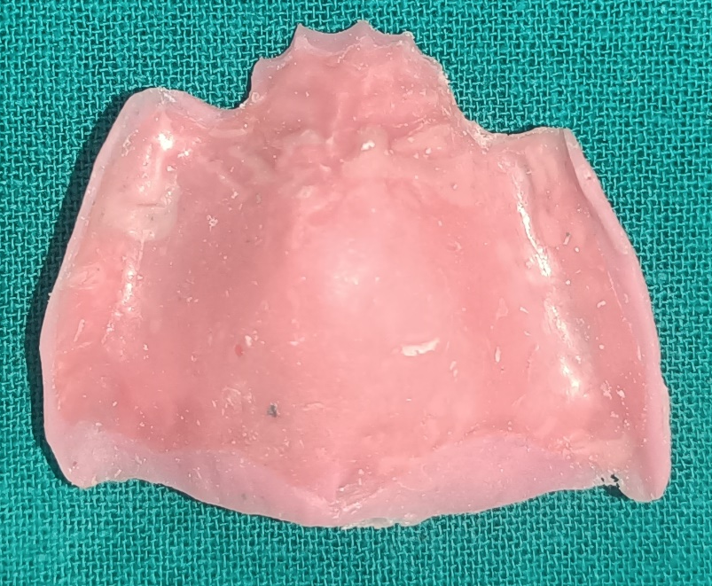
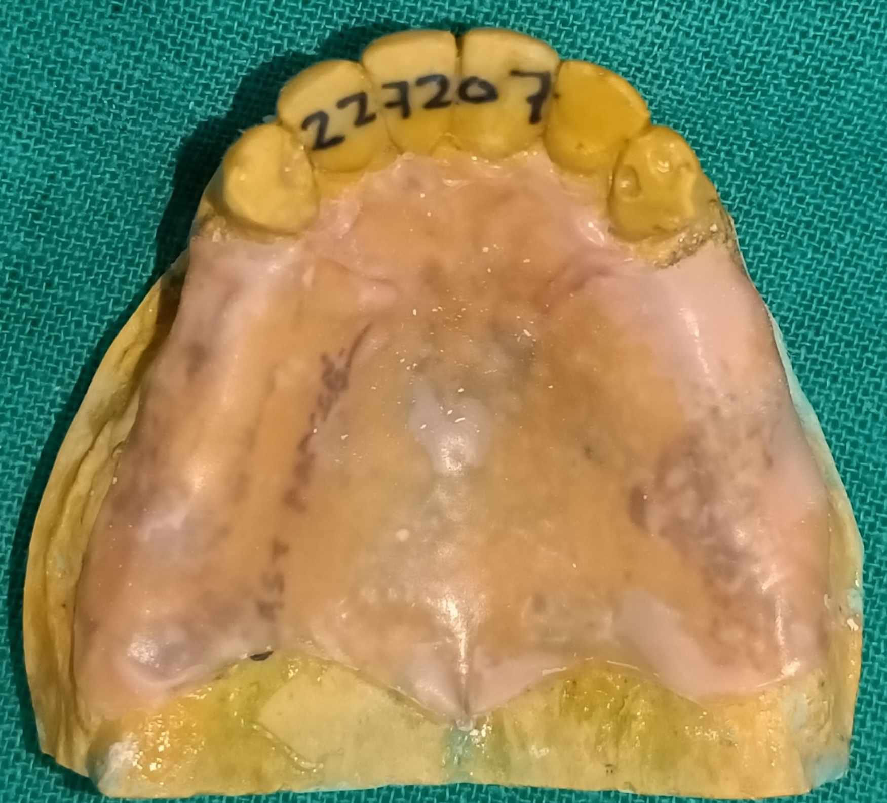
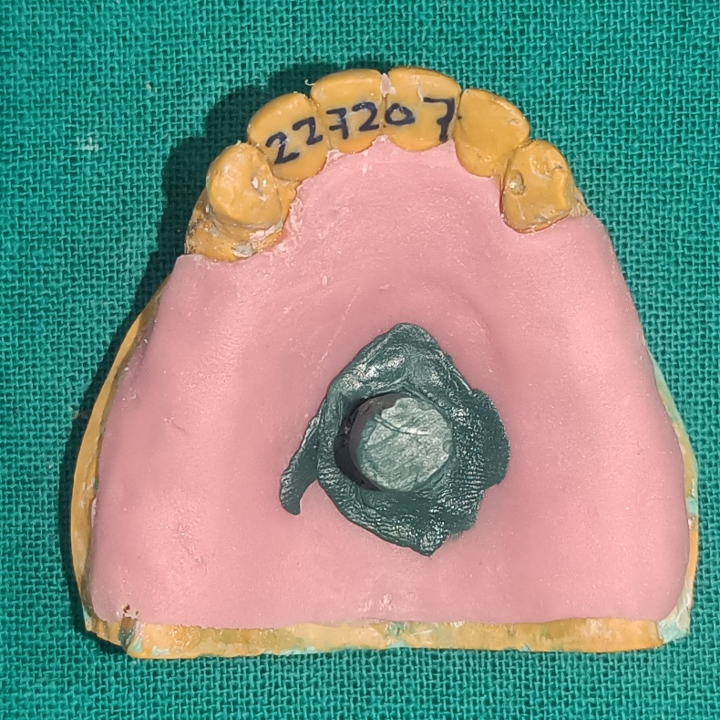
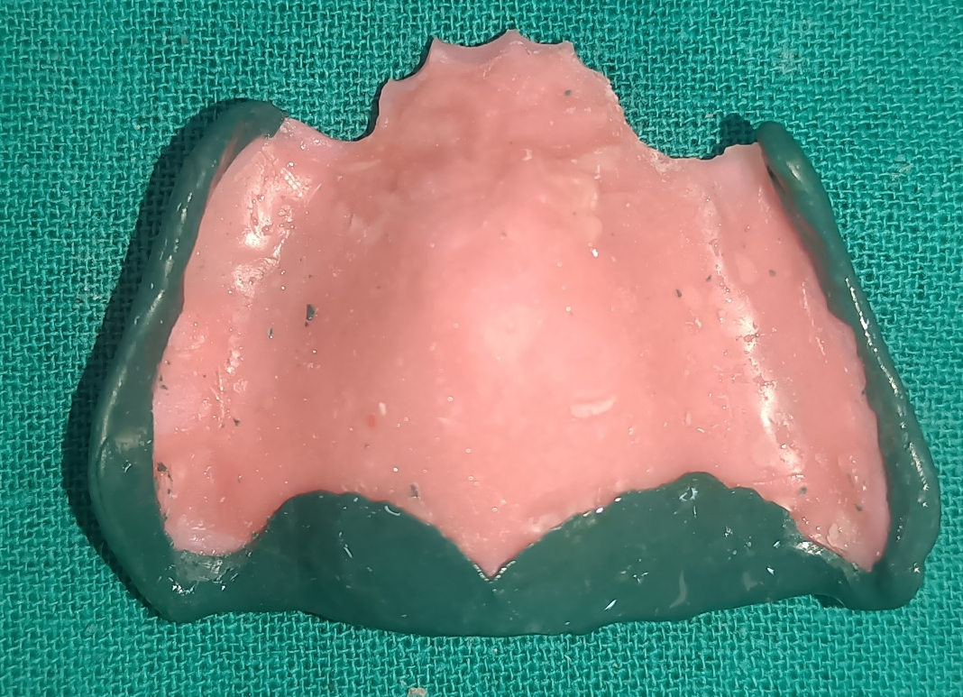
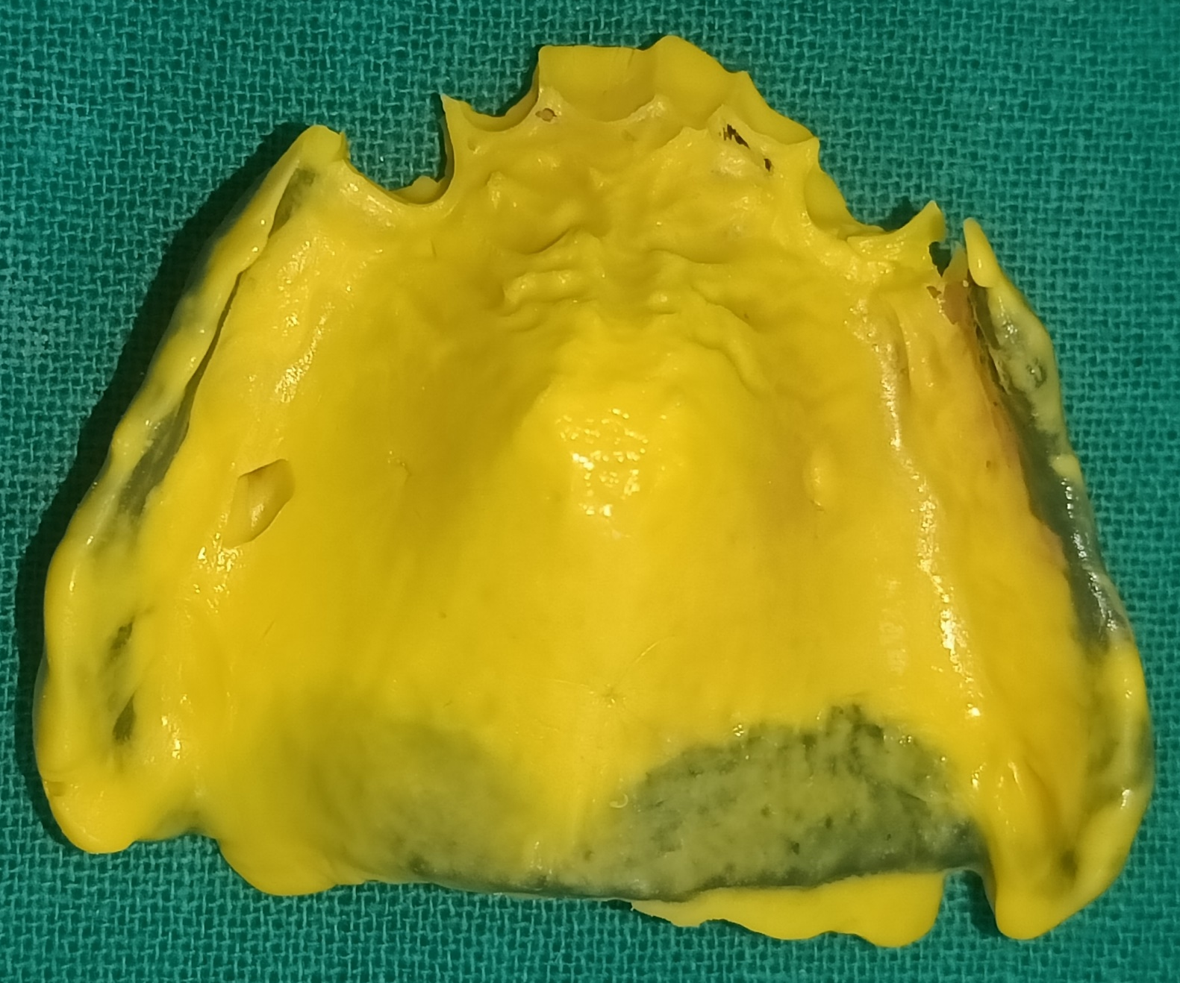
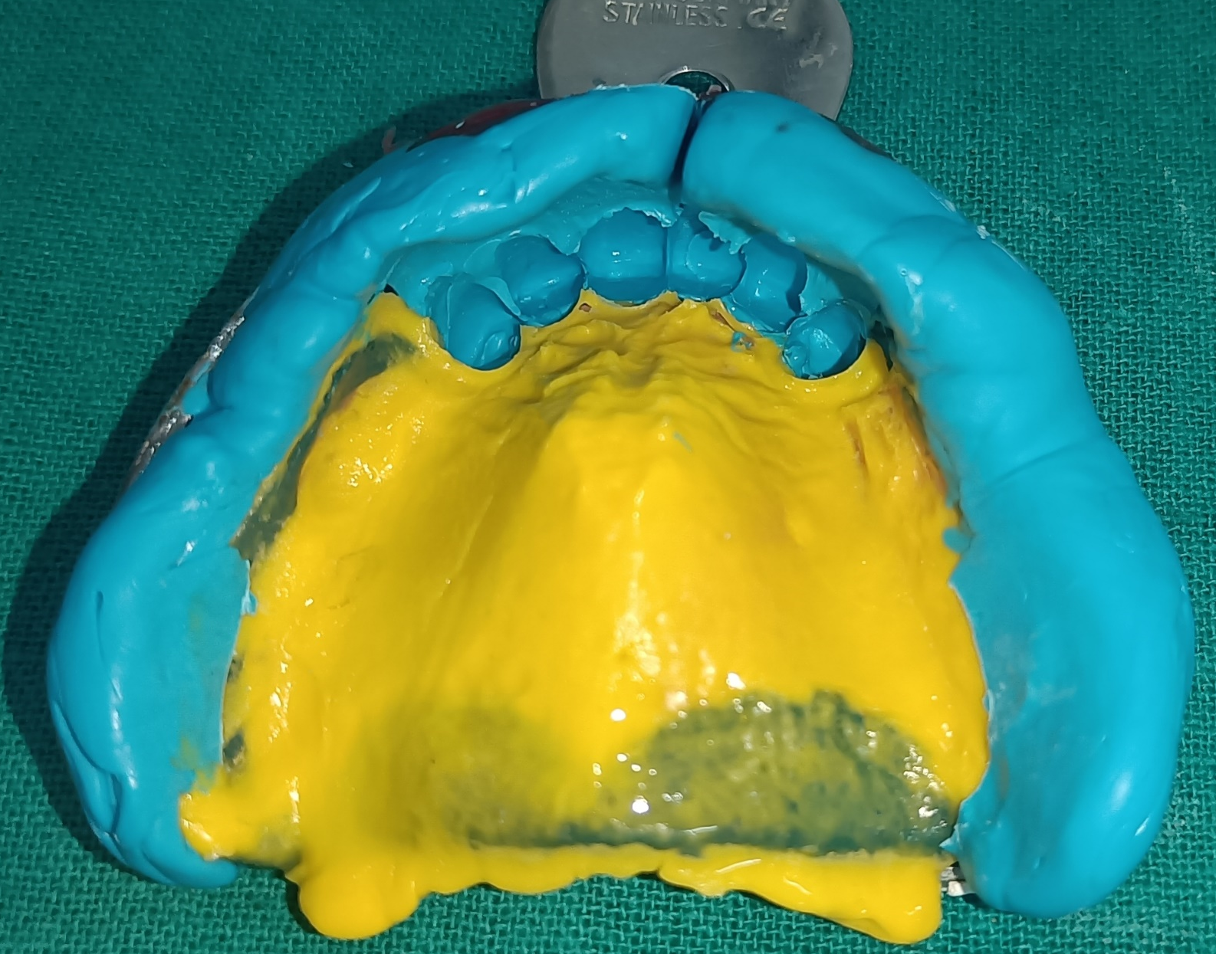

Slide 24
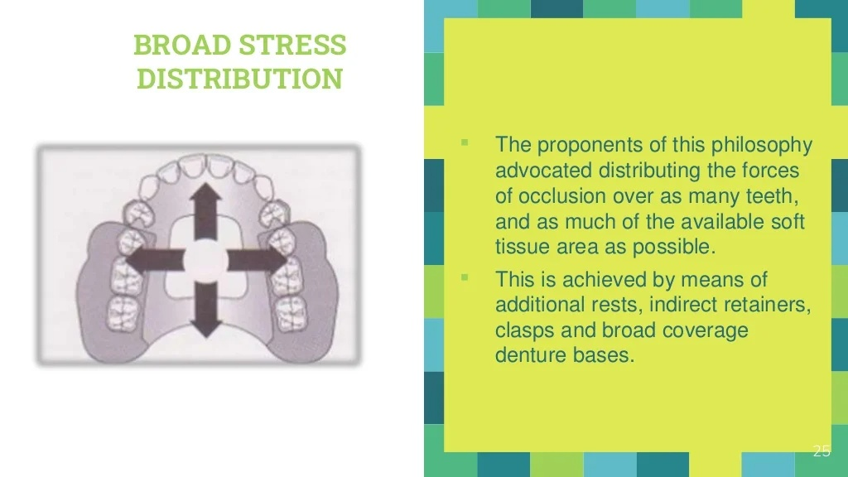

Slide 25
Out of these three philosophies,
Stress equalization has few advocates.
Broad stress distribution is the most widely used philosophy and will be followed in the design procedure.

Slide 26
If the physiologic limits of the supporting tissues are respected, then almost any design can be successful.
Notes:
The challenge is primarily in designing class I and II arches and to some extent in class IV arches and distributing the forces acting on the removable partial denture between the soft tissues and teeth.

Slide 27
